Slide 1
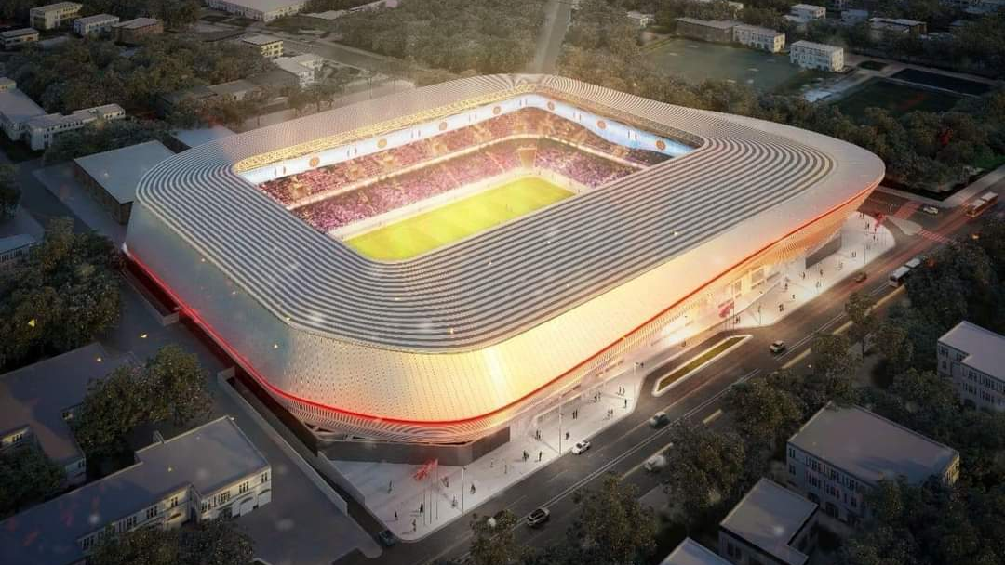
Prince Moulay El Hassan Stadium
Ayoub Askour
Ans Elkabir

Slide 2
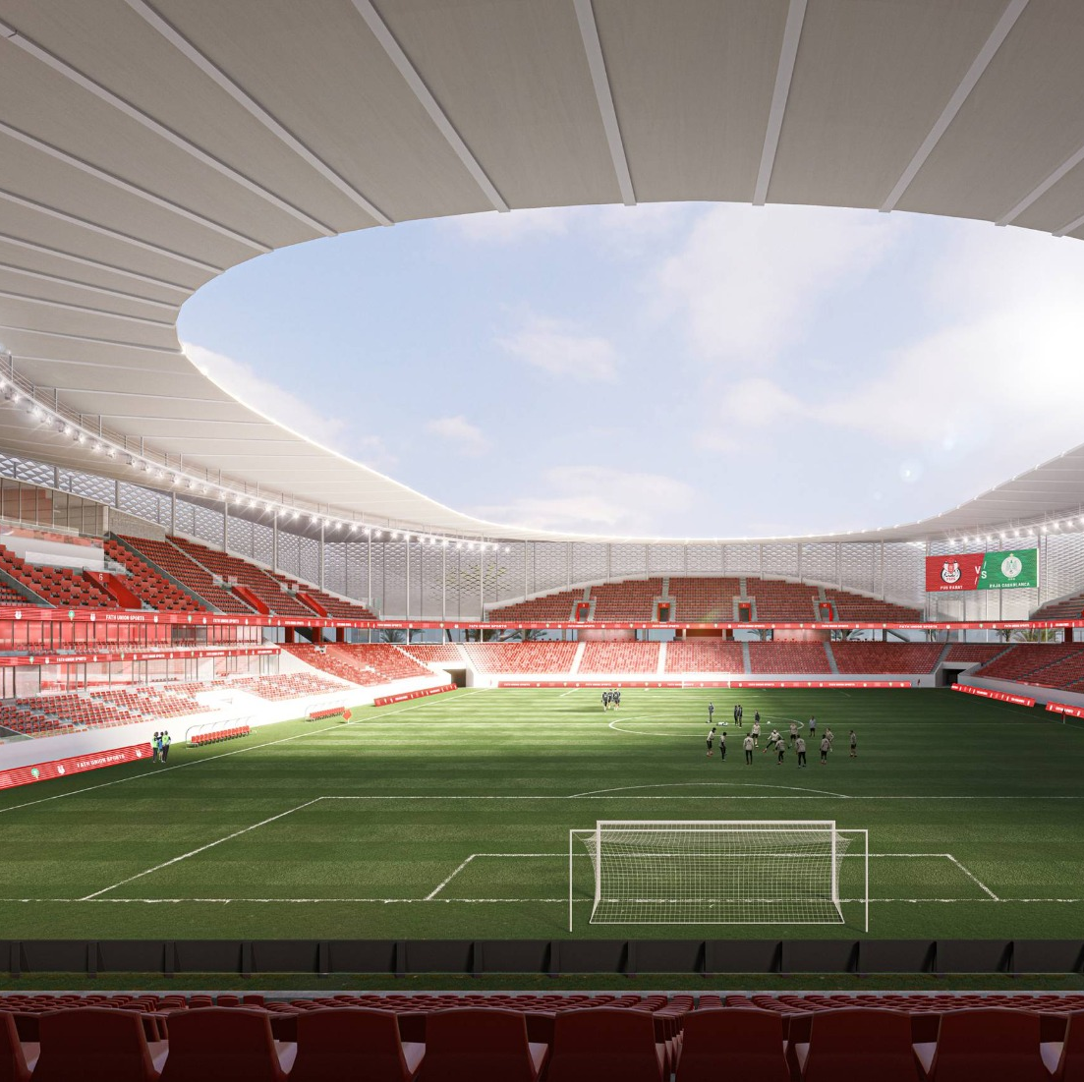
Prince Moulay El Hassan Stadium
Rabat, Morocco
Old capacity: 12,000 → New capacity: 22,000
Originally opened in 1983, renovated in 2012
Old stadium was completely demolished in 2024 and rebuilt from scratch
Cost: about 800 million Moroccan dirhams

Slide 3
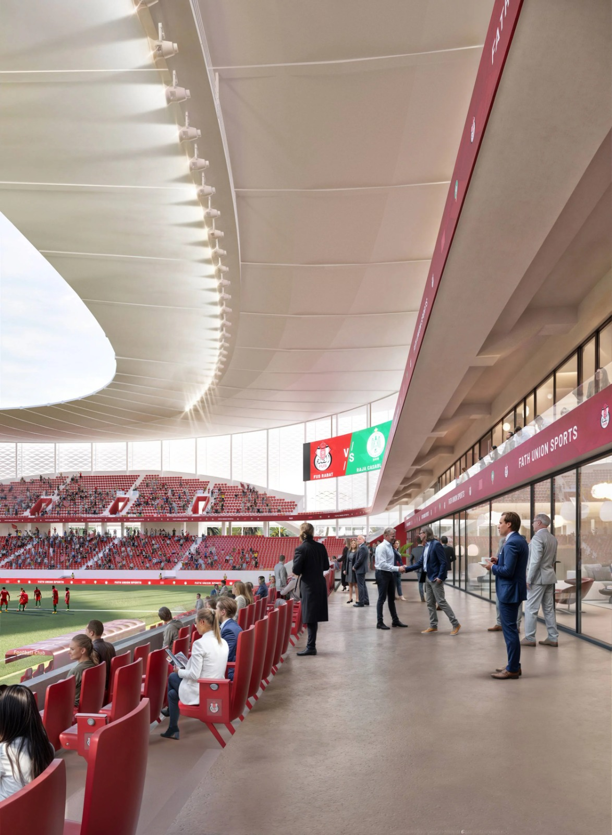
What is Primavera?
Primavera (P6) – Project Management Software
Used for planning, scheduling, and controlling projects
Widely used in engineering and construction
Developed by Oracle Corporation
Project scheduling (activities & timelines)
Resource management (labor, materials)
Cost control and budgeting
Risk analysis
Progress tracking

Slide 4
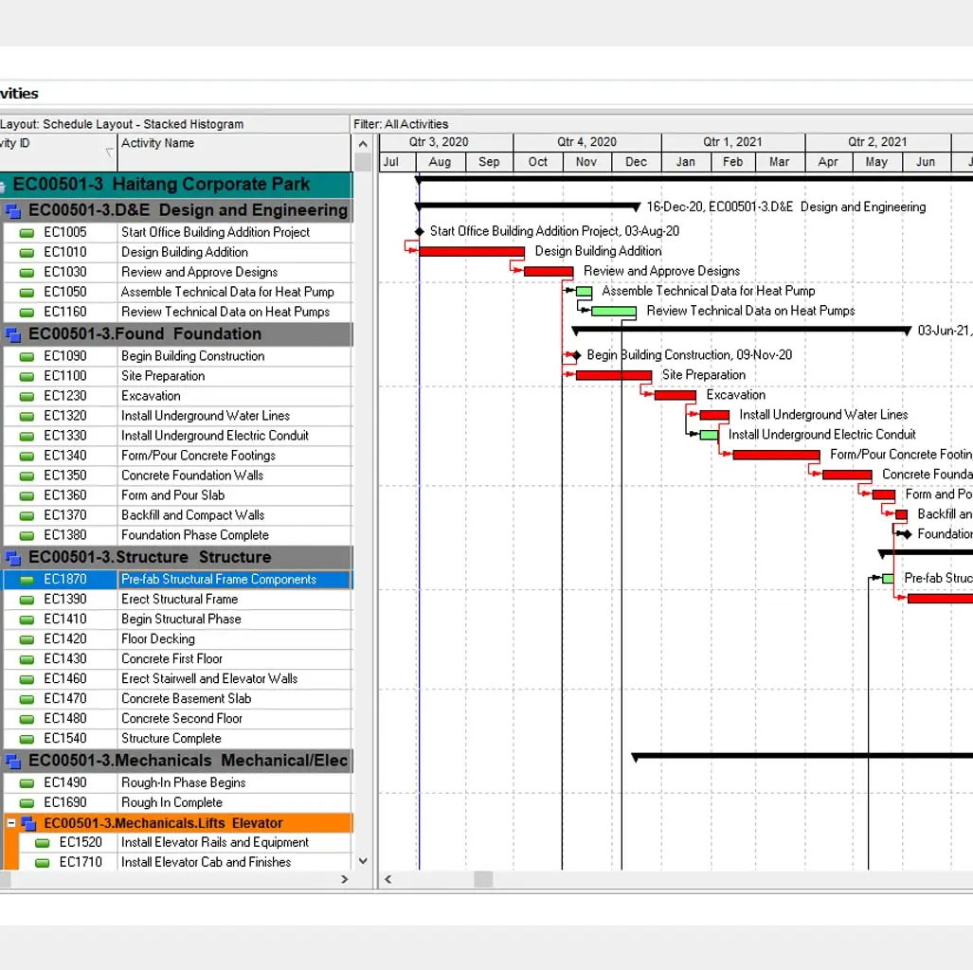
Why Use Primavera?
Handles very large projects easily
Improves planning accuracy
Helps identify delays early
Supports teamwork and reporting

Slide 5
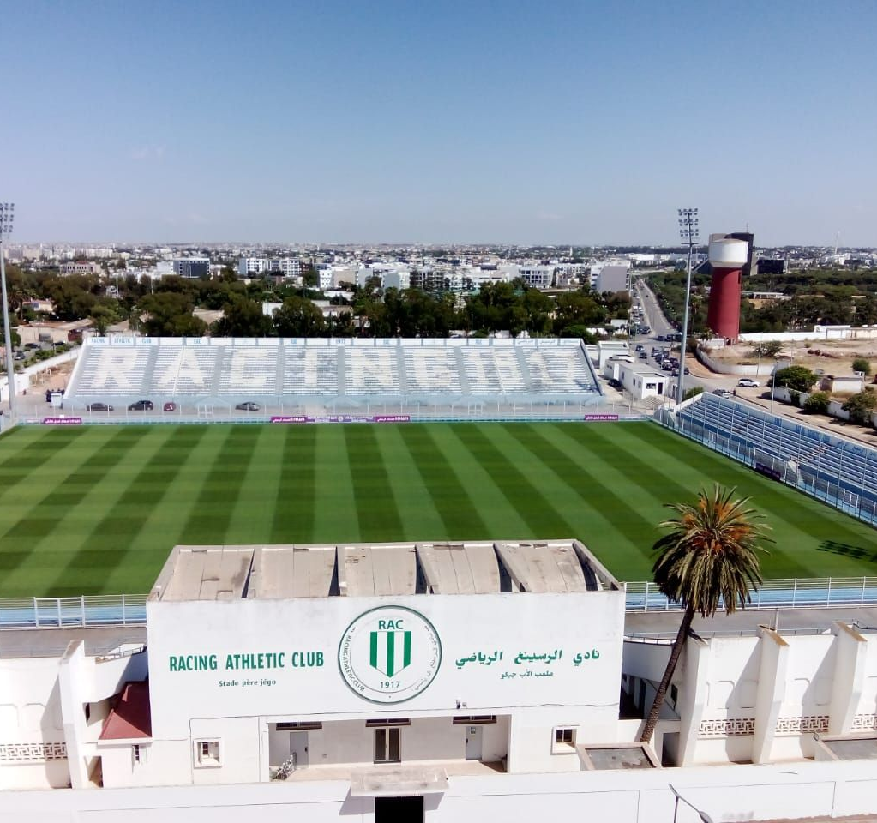
Where is it Used?
Construction projects (buildings, dams, roads)
Infrastructure projects
Industrial and manufacturing projects
Government and mega projects

